Slide 1

Credit Risk Assessment
Team 5
Likhitha Guggilla
Mrugal Pramod Nikhar
Pawan Manikanta Reddy Pamireddy
Sai Krishna Rangabashyam Gomathi
Biao Wang
Alison Wenman
© Team 5
Notes:
Audio - Alison

Slide 2
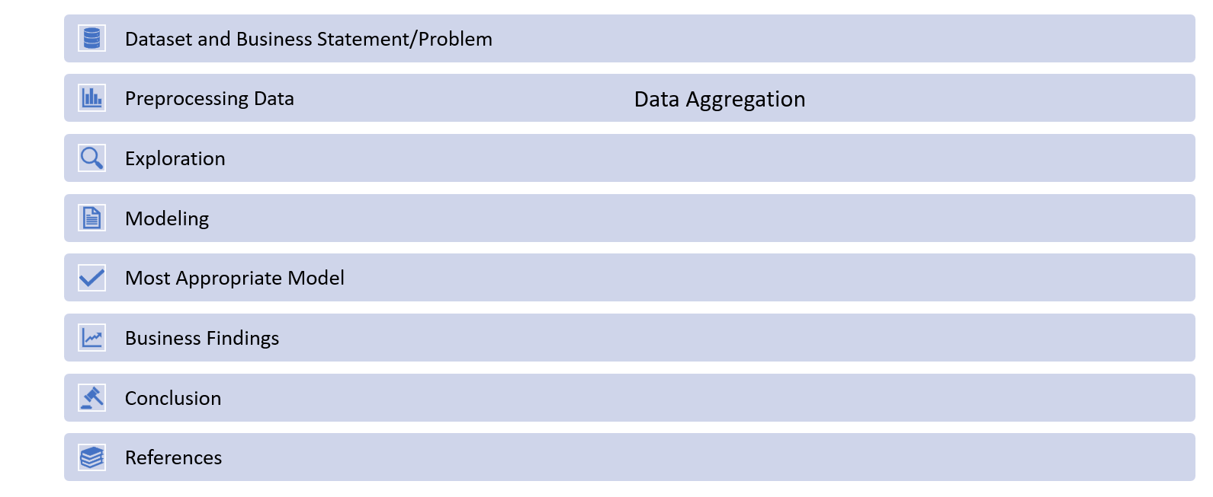
Agenda
Notes:
Audio - Alison

Slide 3

Problem Statement
Business Question:
How to accurately identify high-risk and low-risk customers more effectively to make informed lending decisions while reducing the manual efforts to do so?
Notes:
Audio - Alison

Slide 4
Dataset
Dataset
Credit score classification
Dimensions
100,000 Rows × 27 columns
Target variable
Credit_Score (Good, Standard, Poor)
*Link of the Original Data: https://www.kaggle.com/datasets/parisrohan/credit-score-classification?select=train.csv
Risk (Low Risk, High Risk)
Notes:
Audio - Alison

Slide 5
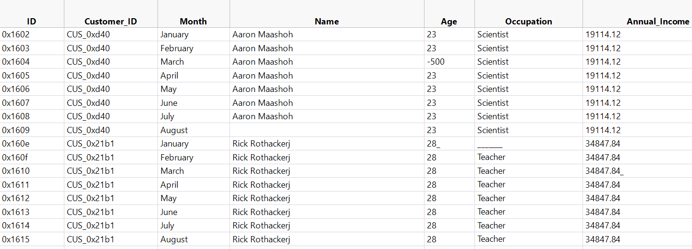
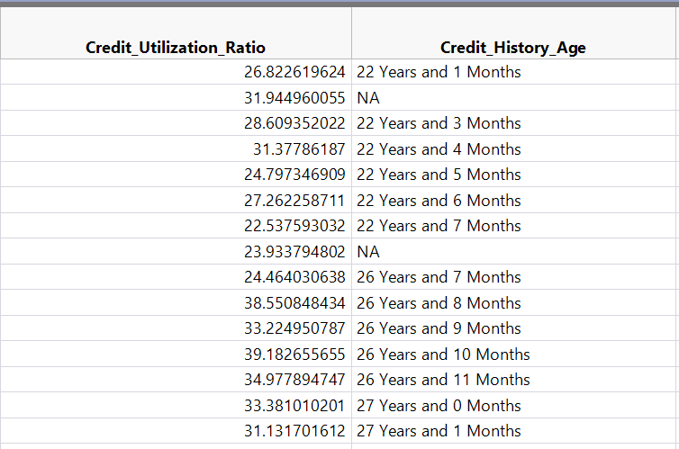
Original Dataset
Challenge:
8 records for each customer with redundant information in the columns like age,occupation etc)
Notes:
Audio - Alison

Slide 6
Data Aggregation

Slide 7
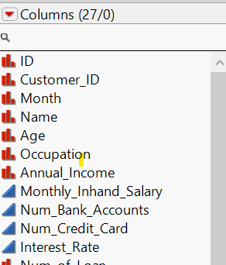
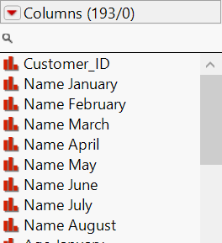
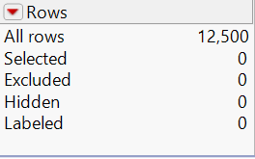
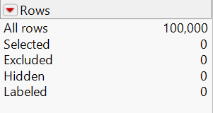
Split the Dataset
Before
After
Notes:
Audio - Mrugal

Slide 8
Column Aggregation
Type 1 | Type 2 | Type 3
Type_of_Loan | Occupation | Age
Num_of_Credit_Inquiries | Annual_Income | Dela_From_Due_Date
Outstanding_Debt | Num_Bank_Accounts | Num_of_Delayed_Payments
 | Num_Credit_Cards | Changed_Credit_Limit
 | Interest_Rate | Credit_Utilization_ratio
 | Num_of_Loan | Amount_Invested_Monthly
 | Credit_Mix | Monthly_Balance
 | Credit_History_Age | Credit_Score
 | Payment_of_Min_Amount
 | Total_EMI_per_Month
Type 1: Constant Data Over Time
For variables with constant data throughout the time period, August data is considered.
Type 2: Constant Data with Missing Values or Outliers
For variables with constant data but August has too many missing values or outliers, a Formula column is used to extract valuable information.
Type 3: Changing Data Over Time
If the variable exhibits changes every month, the average value of the 8 columns is considered.
Notes:
Audio - Mrugal

Slide 9
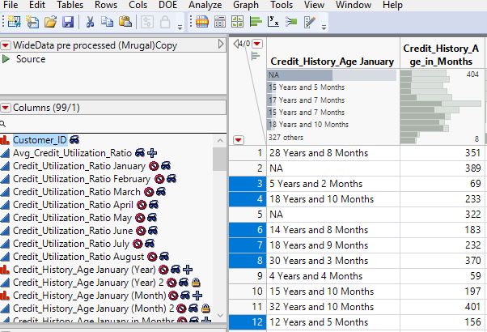
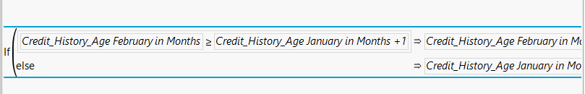
Type 2: Example
Credit_History_Age
Separated years and months from the column data.
Converted extracted data into numeric format.
Converted numeric values to months for standardization.
Added 1 to each value, compared it with subsequent column entries, and iteratively repeated the process for analysis.
Notes:
Audio - Mrugal

Slide 10
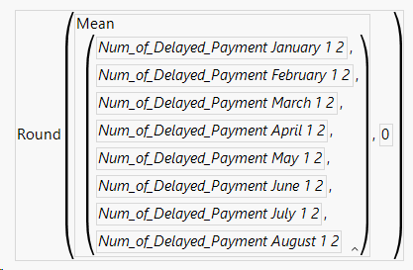
Type 3: Example
Num_of_Delayed_Payments
We can take average but there are some data entry errors(-1,-2,-3,1_..) and too many outliers so follow below steps
Remove ‘_’ using “text to columns” utility and Recode data entry errors like ‘-1,-2…”
Convert outliers to missing values
Create new column
Use Mean
Notes:
Audio - Mrugal

Slide 11
Data Preprocessing
Notes:
Audio - Biao

Slide 12
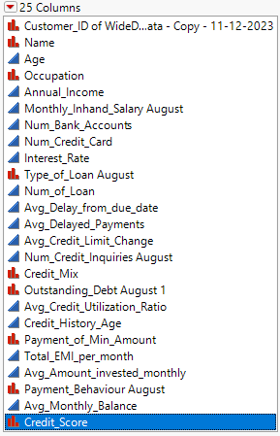
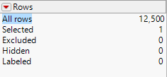
Data Set
Before
After
Original Dataset
100,000 Records × 27 columns
After Aggregated Dataset
12,500 Records × 25 columns
(*ID Column is excluded )
(*Month column was split into 8 )
Notes:
Audio - Biao

Slide 13
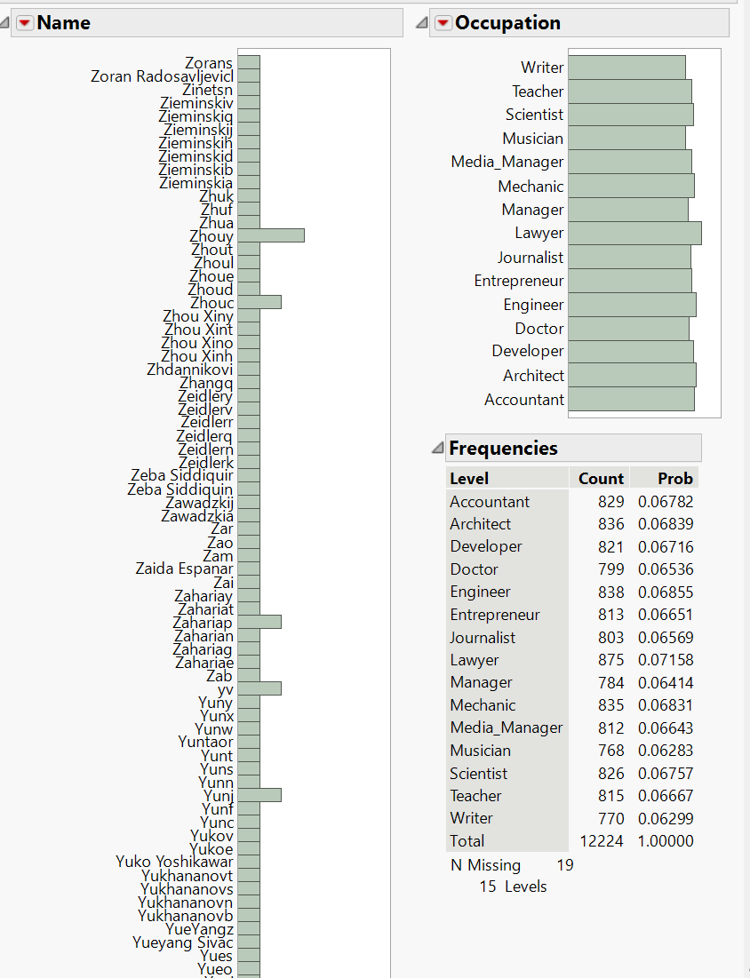
Column Elimination
Unique values and No impact on Target Variable
1. Name
2. Occupation
Redundant Information
Monthly_inhand_Salary
(directly proportional to Annual_Income)
Notes:
Audio - Biao

Slide 14
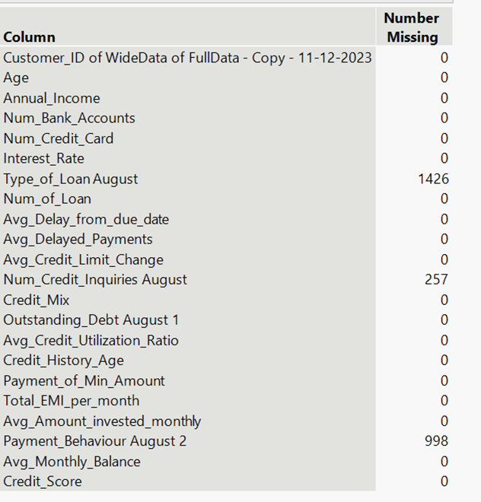
Missing values
2 columns
(i.e. Type_of_Loan and Payment_Behaviour) is excluded
257 records deleted
12,243 Records × 20 columns
Notes:
Audio - Biao

Slide 15
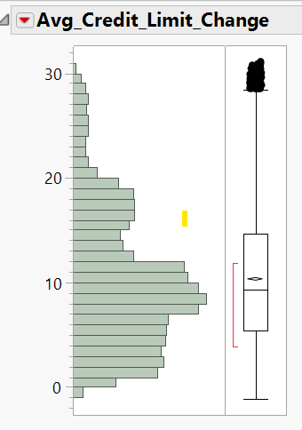
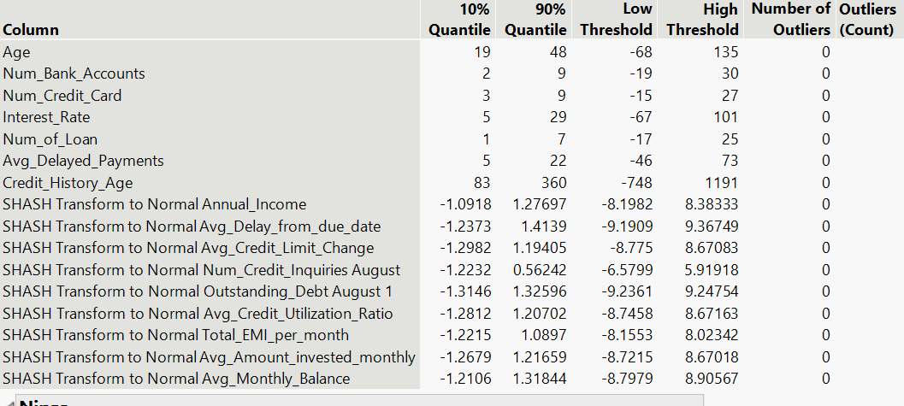
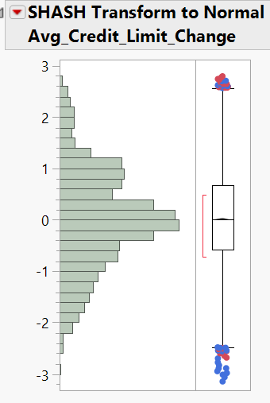
Univariate Outlier Analysis
Distribution Plots
Outlier Screening – ‘Explore Outliers’
Transformed
Notes:
Audio - Sai

Slide 16
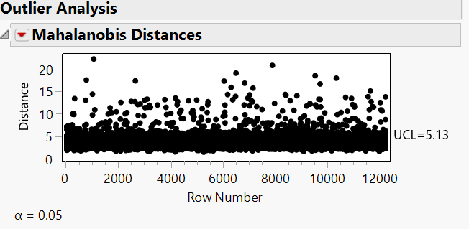
Multivariate Outlier Analysis
Mahalanobis Distance – 3801 Records excluded
Notes:
Audio - Sai

Slide 17
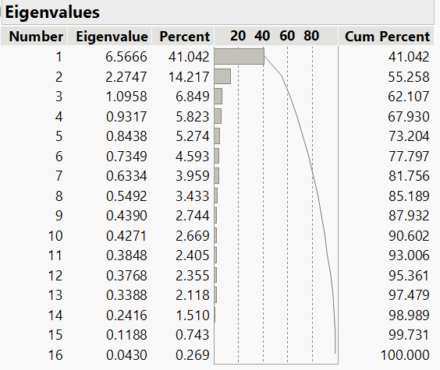
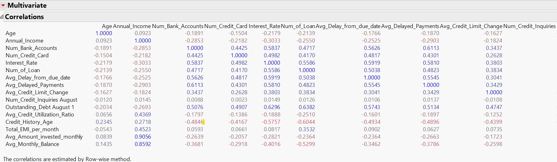
PCA
Eigen values of principal components
Eliminate Redundant Information in continuous predictor variables using principal components
11 Principal Components retain 93% information
Correlation b/w continuous variables
Notes:
Audio - Sai

Slide 18
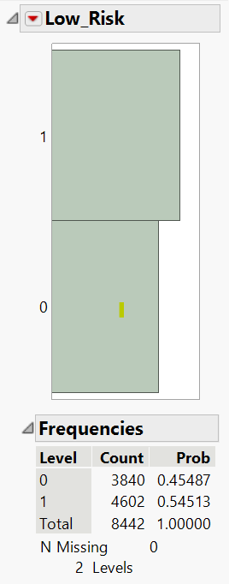
Target Variable Distribution
After Preprocessing​
Dataset (with PCA) - 8442 Rows × 14 columns​
Datset (without PCA) - 8442 Rows × 21 columns​
Dataset (with significant variables) - 8442 Rows × 9 columns​
​
Partition (60-20-20)​
Train – 5065 records​
Validation – 1688 records​
Test – 1689 records
In target variable,1’s and 0’s are in approx equal proportion. Therefore, no need to do stratified validation column
Notes:
Audio - Sai

Slide 19
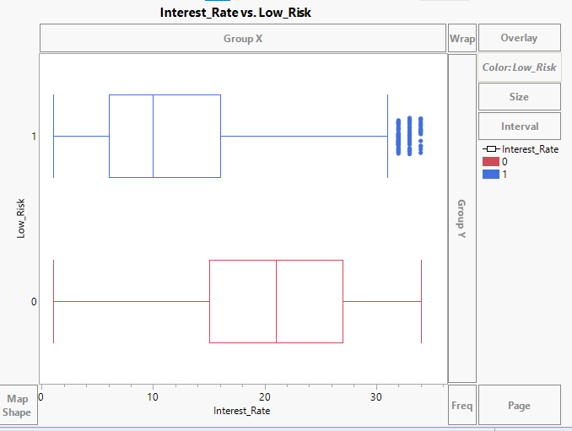
Exploratory Data Analysis
Interest vs. Low risk: The box plot indicates that the interest rate is lower for the Low risk.
On the other hand, the interest rate is higher for increased risk.
Notes:
Audio - Mrugal

Slide 20
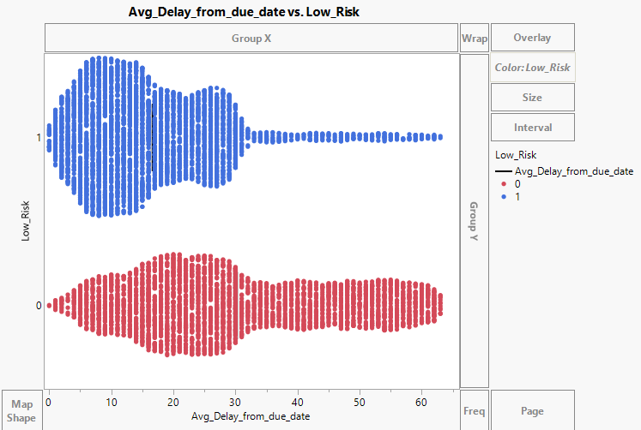
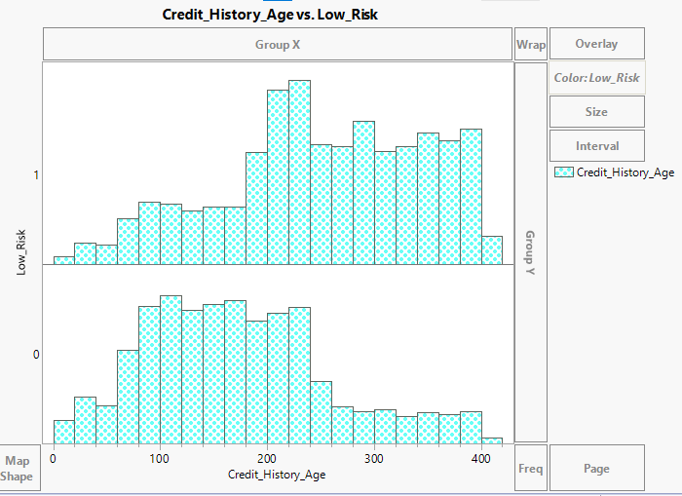

Avg Delay from due date vs. Low Risk: Based on the graph, we are able to determine that clients with high credit history ages are at low risk, while those with low credit histories are at high threat.
Credit History Ages vs. Low Risk: Based on the graph, we are able to determine that clients with high credit history ages are at low risk, while those with low credit histories are at high threat.
Notes:
Audio - Mrugal

Slide 21
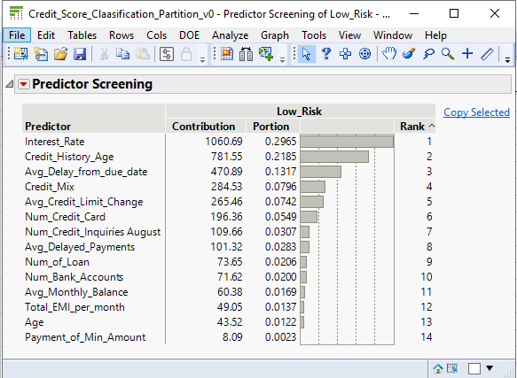
The most pertinent and instructive predictions are chosen through predictor screening.
By removing superfluous, pointless, or noisy features and concentrating on variables that actually aid in the prediction of the goal variable, these suggestions seek to improve the caliber and efficacy of predictive models.
Notes:
Audio - Mrugal

Slide 22
Models

Slide 23
Models
We used below models for our dataset
Decision Tree
Logistic Regression
Neural Network
Bootstrap Forest
Boosted Tree
Discriminant Analysis
K-Nearest Neighbour (KNN)
Naïve Bayes
Notes:
Audio - Pawan

Slide 24
Models are trained and tuned considering 3 different subset of variables​
Full Variables ( 18 variables)​
Reduced Variables (9 Significant Variables)​
Full Variables (11 Principal Components)
Notes:
Audio - Pawan

Slide 25
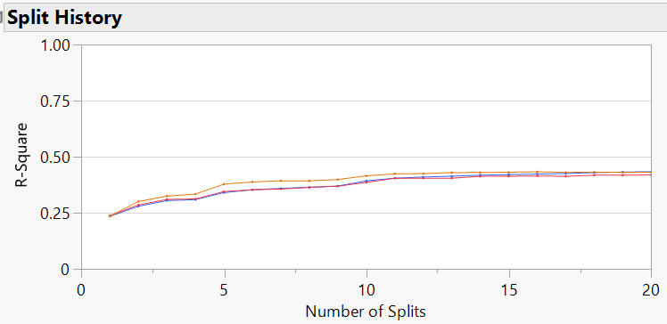
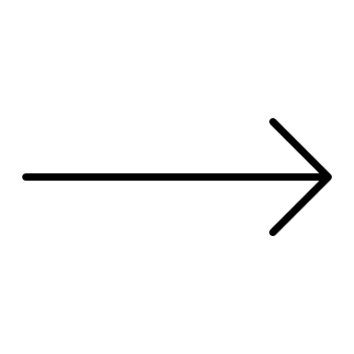
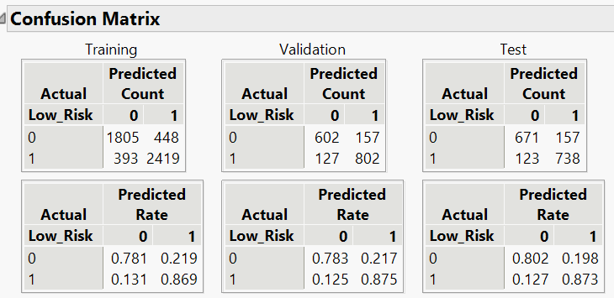
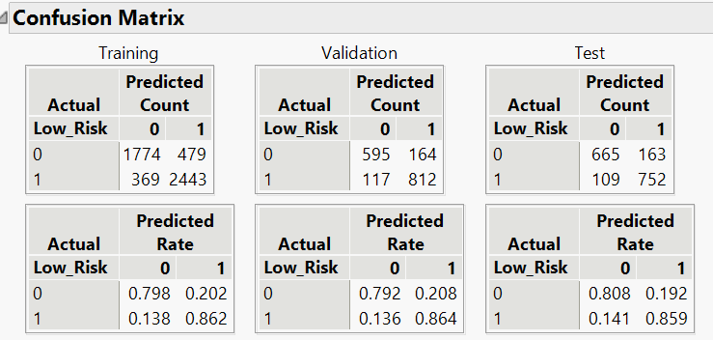
Decision Tree
Optimal point
No.of Splits - 11
Build decision tree with all predictors
Max splits – 20
Prune the tree to 11 splits
Reduce the model complexity
No difference Misclassification rate
Number of splits - 20
Number of splits -11
Notes:
Audio - Pawan

Slide 26
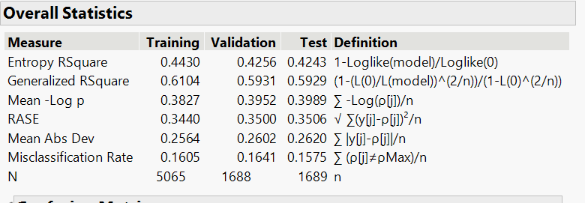
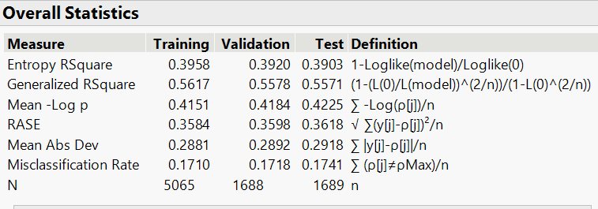
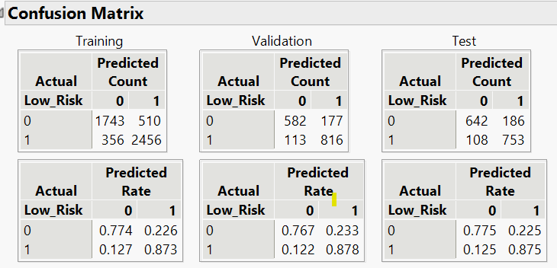
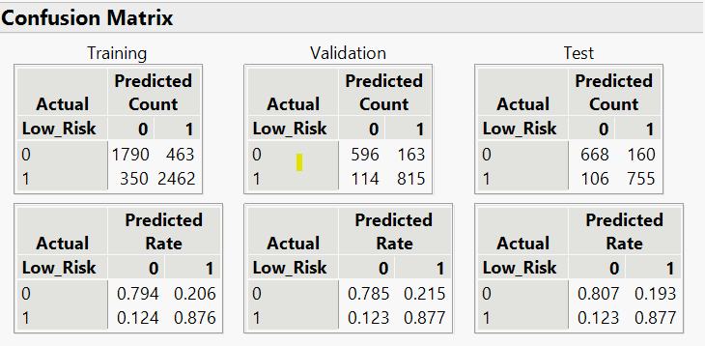
Boosted Tree
Run model with different no.of layers and splits
50 layers and 3 splits, 20 layers and 3 splits
20 layers 3 splits
50 layers 3 splits
Notes:
Audio - Pawan

Slide 27
Assess
Consider the following metrics to assess the model performance on Test dataset
Total Accuracy
Total 1's Accuracy
Sensitivity
RASE
Model Cost
False Positives ( High risk customers predicted as low risk) >
}
HIGH
}
LOW
False Negatives( Low risk customers predicted as high risk)
Notes:
Audio - Likhitha
Till now, The models have been trained and tuned based on three distinct subsets of variables . Now, Our objective is to select the optimal model by evaluating its performance on key metrics. We aim to choose a model with elevated total accuracy, total 1's accuracy, and sensitivity, coupled with lower Root Average Squared Error and model cost.
Our emphasis is on minimizing False Positives (FPs) over False Negatives (FNs) due to the more substantial negative impact associated with FPs. To elaborate, in cases where the model incorrectly predicts a customer as low-risk when they are, in fact, high-risk, there is a lower likelihood of loan repayment. If the customer fails to repay, the business incurs significant financial burdens. Therefore, prioritizing the reduction of False Positives is crucial to mitigate potential financial risks for the business.

Slide 28
Full Predictor variables
After model is trained and tuned using all predictor variables, Decision tree is identified as the best model
Model | Logistic | Decision tree | Bootstrap | Boosted | Neural | Naïve Bayes | KNN | Discriminant
TP | 736 | 752 | 745 | 753 | 731 | 703 | 750 | 722
TN | 605 | 665 | 635 | 642 | 650 | 633 | 610 | 626
FP | 223 | 163 | 193 | 186 | 178 | 195 | 218 | 202
FN | 125 | 109 | 116 | 108 | 130 | 158 | 111 | 139
Total Accuracy | 79.40% | 83.90% | 81.71% | 82.59% | 81.76% | 79.10% | 80.52% | 79.81%
Accuracy of 1 | 76.75% | 82.19% | 79.42% | 80.19% | 80.42% | 78.29% | 77.48% | 78.14%
Misclassification rate | 20.60% | 16.10% | 18.29% | 17.41% | 18.24% | 20.90% | 19.48% | 20.19%
Sensitivity | 85.48% | 87.34% | 86.53% | 87.46% | 84.90% | 81.65% | 87.11% | 83.86%
Notes:
Audio - Likhitha
This table displays the metrics for the optimal models, all of which were trained using every predictor variable. Upon thorough analysis, we determined that the Decision Tree model outperforms the others. It exhibits superior total accuracy and total 1's accuracy compared to all alternative models. Notably, the Decision Tree model demonstrates a lower incidence of False Positives (FPs) and False Negatives (FNs), resulting in a reduced overall model cost compared to the alternative models. As a result of these favorable characteristics, we have selected the Decision Tree as the best-performing model among those utilizing all predictor variables.

Slide 29
Significant variables Considered for Modeling
Through a comprehensive study of variable contribution summaries across all models, we have identified the key predictor variables. By utilizing both predictor screening procedures and exploratory data analysis, we have thoroughly confirmed the importance of these identified variables.
Outstanding_Debt
Avg_Delay_from_due_date
Avg_Credit_Limit_Change
Num_Credit_Card
Avg_Delayed_Payments
Credit_History_Age
Interest_rate
Num_of_Loan
Num_Credit_Inquiries
Notes:
Audio - Likhitha
In the previous slide, We have identified decision tree as the best model when every predictor variable was fed to the model. Now, we are going to assess the model performance of the models that are trained and tuned using only these 9 significant variables. These were identified by performing different explorations.

Slide 30
Significant Predictor variables
After model is trained and tuned using only significant predictor variables, Decision tree is identified as the best model
Model | Logistic | Decision tree | Bootstrap | Boosted | Neural | Naïve Bayes | KNN | Discriminant Analysis
TP | 734 | 743 | 754 | 754 | 734 | 748 | 743 | 721
TN | 601 | 679 | 656 | 645 | 658 | 605 | 626 | 613
FP | 227 | 149 | 172 | 183 | 170 | 223 | 202 | 215
FN | 127 | 118 | 107 | 107 | 127 | 113 | 118 | 140
Total Accuracy | 79.04% | 84.07% | 83.48% | 82.83% | 82.42% | 80.11% | 81.05% | 78.98%
Accuracy of 1 | 76.38% | 83.71% | 81.43% | 80.47% | 81.19% | 77.03% | 78.62% | 77.03%
Misclassification rate | 20.96% | 15.93% | 16.52% | 17.17% | 17.58% | 19.89% | 18.95% | 21.02%
Sensitivity | 85.25% | 86.92% | 87.57% | 87.57% | 85.25% | 86.88% | 86.30% | 83.74%
Notes:
Audio - Likhitha
In this slide, we've summarized the performance metrics of various models that are trained and tuned with only 9 significant variables which were mentioned in the previous slide. After thorough analysis, we have identified decision tree as the best model. Even though there are other models with similar good metrics like bootstrap,boosted with similar accuracy and sensitivity, we've chosen the Decision Tree as the standout performer. This is because, If we focus on FP's and FN's,The Decision Tree excels in reducing the model cost by maintaining a fine balance between False Positives (FPs) and False Negatives (FNs) when compared to other models. What sets it apart is its ability to predict low FPs, which is crucial for minimizing negative impacts on the business. Therefore, we've selected the Decision Tree as the best model among those trained with only the nine significant variables.

Slide 31
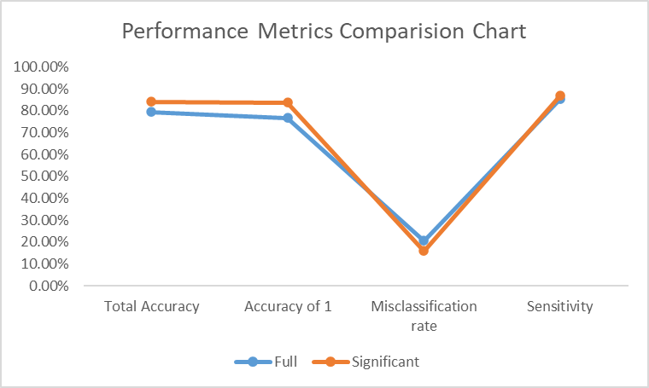
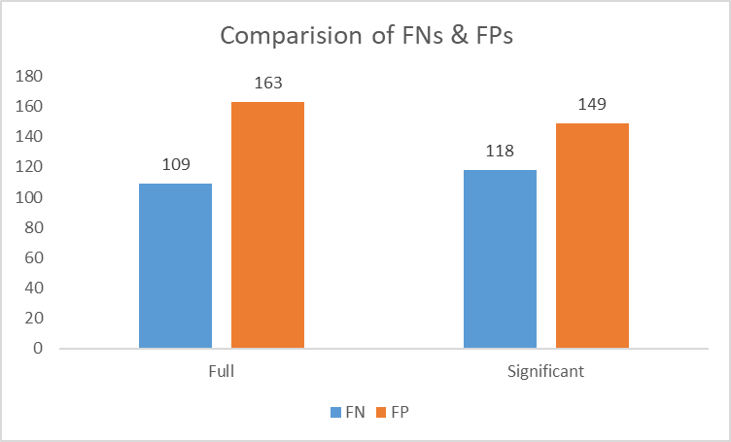
Models Comparison
To choose one best model we are comparing the model performances of the two selected Decision Trees
Full Model - Decision Tree trained on all variables
Significant Model - Decision Tree trained on significant variables
Notes:
Audio - Likhitha
Now we have two best decision tree models, we are comparing their model performance to chose the final best model. Here, to avoid confusion, we have represented the decisiontree trained on all predictor variables as full model and the other one trained on only significant variables as significant model. If we see the performance metrics chart, Significant model has good metrics when compared to full model. Significant model is predicting balanced FP's and FN's .most importantly it is predicting lower FP's which will reduce the model cost.

Slide 32
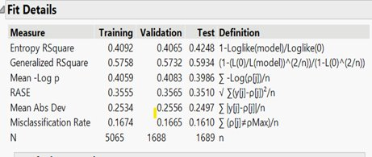
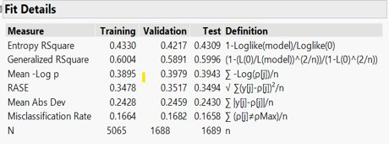
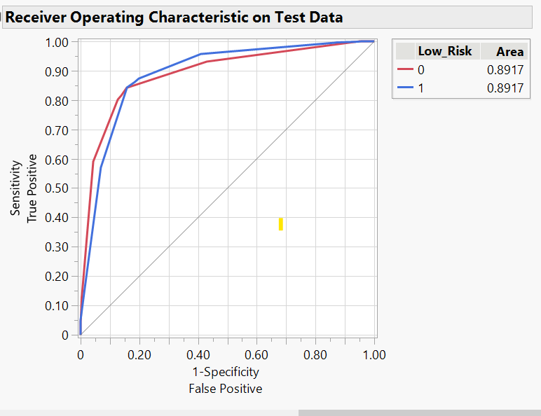
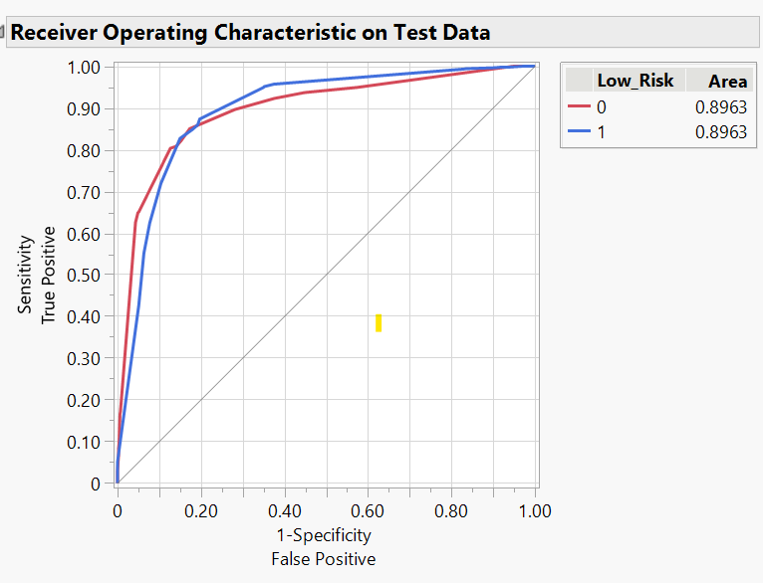
Decrease in RASE and Increase in RSquare
Similar AUC
Notes:
Audio - Likhitha
In this slide, we are looking at the RASE and AUC values of the two models. If we observe the highlighted red box, Significant model has lower RASE value than Full Model which means our Significant Model predictions are more precise compared to Full Model. Considering ROC, both the models have approx same AUC. But we can conclude that Significant Model is the better performer than Full Model because, though it's performance metrics are only slightly better than the Full Model , it's model complexity and model cost is lower and considerable. hence we conclude that Significant model is the best model.

Slide 33
Best Model
After training and evaluating all the models we identified "Decision Tree trained on significant variables(Model 2)" as the best one with
Total Accuracy – 84.07%
Total 1's Accuracy – 83.71%
AUC – 0.8963
RASE – 0.3494
Notes:
We have chosen Decision tree trained on 9 variables as the best model with following performance metrics.

Slide 34
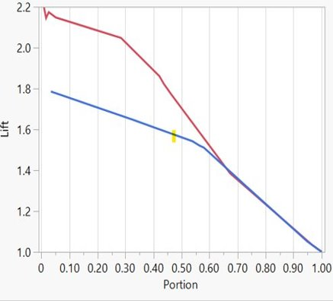
Business Findings
Effective Lending Decisions
Our risk assessment model empowers businesses to make well-founded lending decisions by classifying customers into low-risk or high-risk categories based on their credit history
Strategic Focus on Low-Risk Customers
To mitigate the inherent risks associated with loan repayment, our model recommends a strategic approach for businesses.
By focusing on lending to the top 20% of customers identified as low risk, businesses substantially increase the likelihood of loan repayment. Our analysis indicates that this targeted strategy boosts the chances of successful repayment by 1.7 times compared to a broader customer base.
Notes:
Audio - Likhitha
After training different models and finally choosing one best model, we can conclude that our decision tree model can be used by the business to make well-founded lending decisions by classifying customers into low-risk or high-risk categories. It cut downs the manual effort and time that needs to be put into this risk assessment. One more important finding is that the business can use our model to migigate the risks associated with loan repayment. They can focus only on specific proportion of low-risk customers to lends loans and improve the likelihood of loan repayment.

Slide 35
Appendix

Slide 36
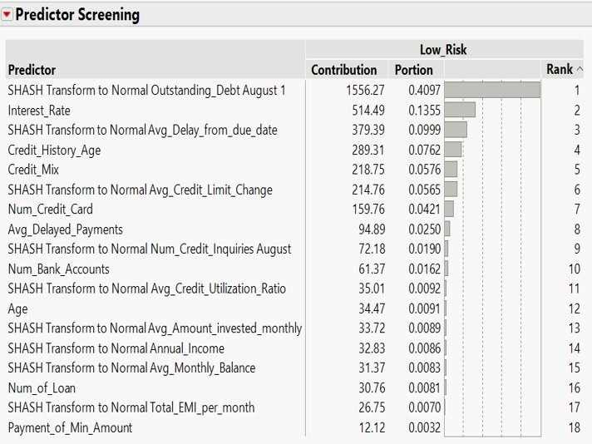
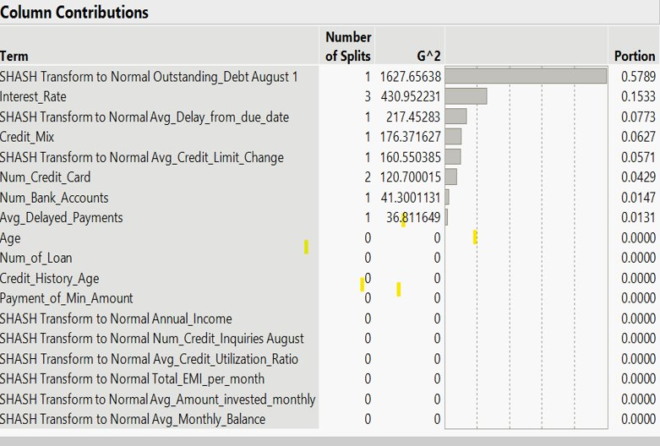
some of the screenshots taken while identifying significant variables are included below:
Predictor Screening
Decision Tree

Slide 37
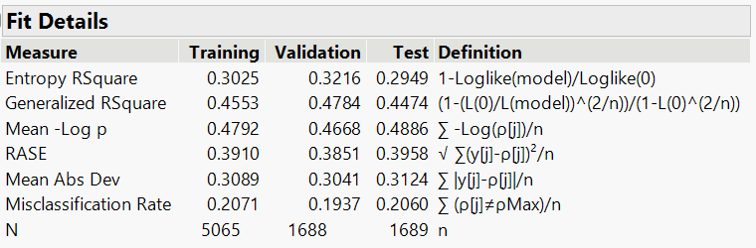
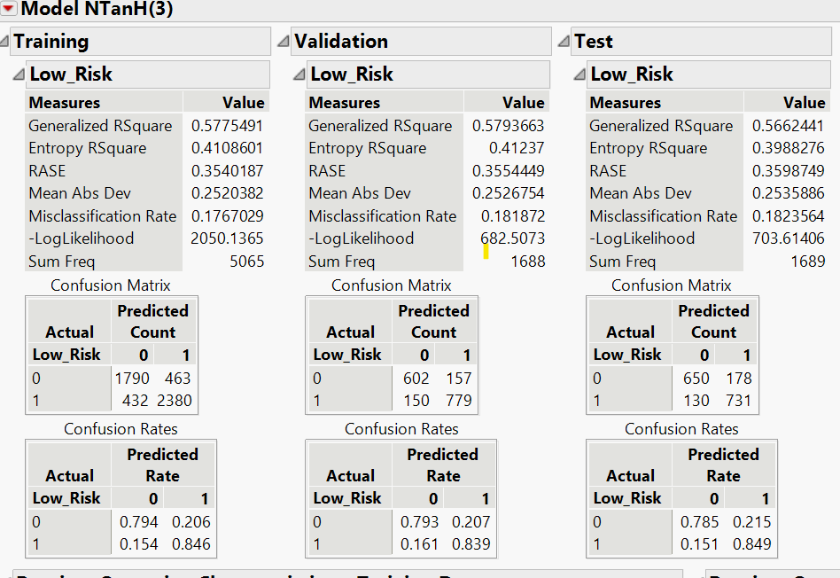
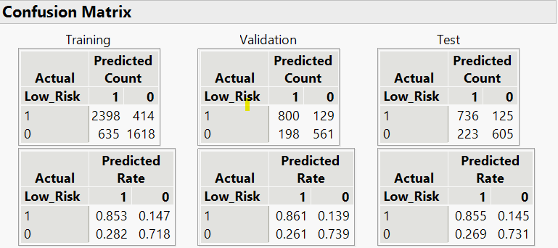
Logistic Regression
Neural Network
Total accuracy : 81.76%
Total accuracy :79.40%

Slide 38
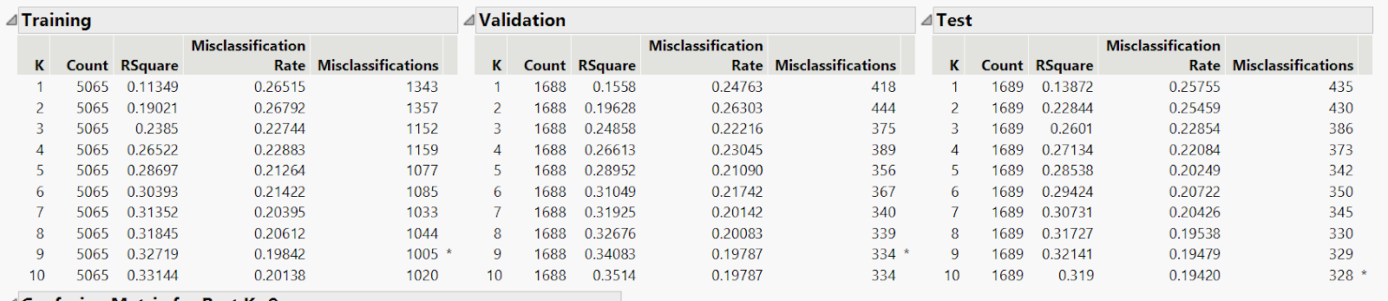
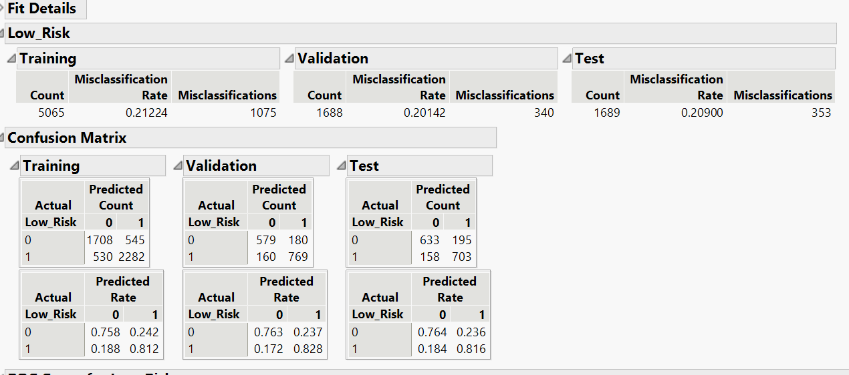
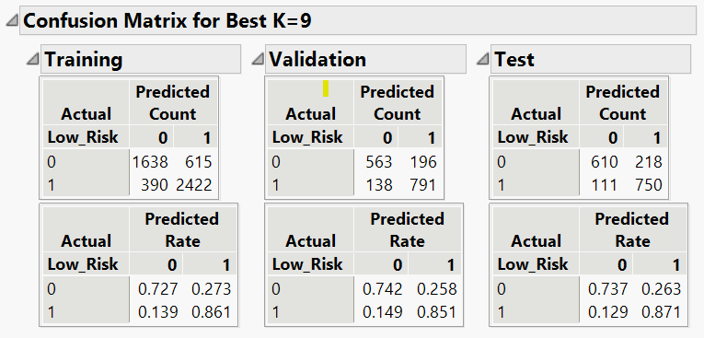
K-Nearest Neighbour(KNN)
Naïve Bayes

Slide 39
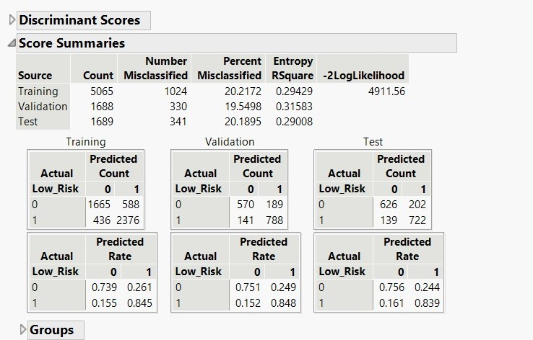
Bootstrap forest
Discriminant Analysis

